Slide 1
Parrot mini-drones & Leap Motion

Slide 2


Slide 3
Technologies?
NodeJS
Websockets
JavaScript

Slide 4
Transition headline
Let’s start with the first set of slides

Slide 5
Quotations are commonly printed as a means of inspiration and to invoke philosophical thoughts from the reader.

Slide 6
This is a slide title
Here you have a list of items
And some text
But remember not to overload your slides with content
You audience will listen to you or read the content, but won’t do both.

Slide 7
BIG CONCEPT
Bring the attention of your audience over a key concept using icons or illustrations

Slide 8
You can also split your content
White
Is the color of milk and fresh snow, the color produced by the combination of all the colors of the visible spectrum.
Black
Is the color of coal, ebony, and of outer space. It is the darkest color, the result of the absence of or complete absorption of light.

Slide 9
In two or three columns
Yellow
Is the color of gold, butter and ripe lemons. In the spectrum of visible light, yellow is found between green and orange.
Blue
Is the colour of the clear sky and the deep sea. It is located between violet and green on the optical spectrum.
Red
Is the color of blood, and because of this it has historically been associated with sacrifice, danger and courage.

Slide 10
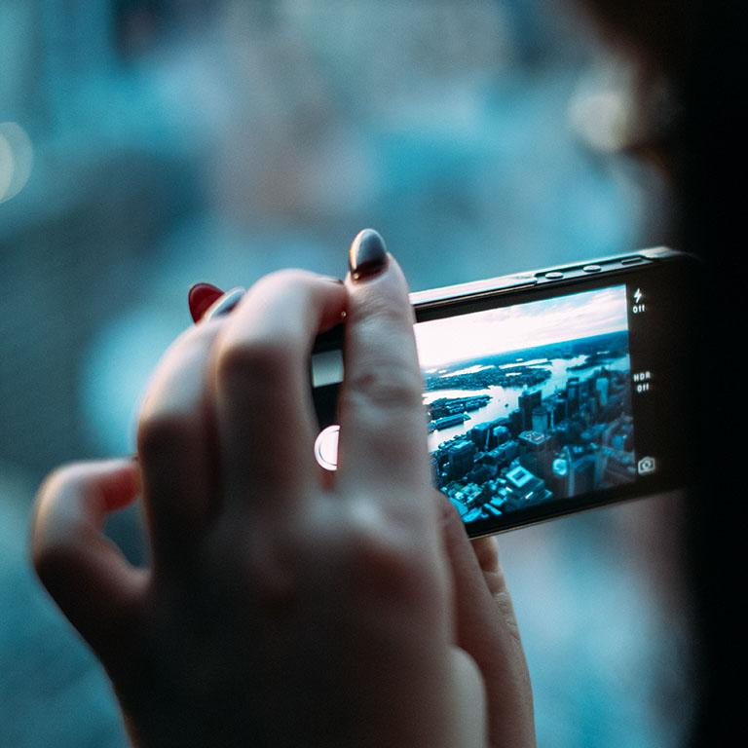
A picture is worth a thousand words
A complex idea can be conveyed with just a single still image, namely making it possible to absorb large amounts of data quickly.

Slide 11
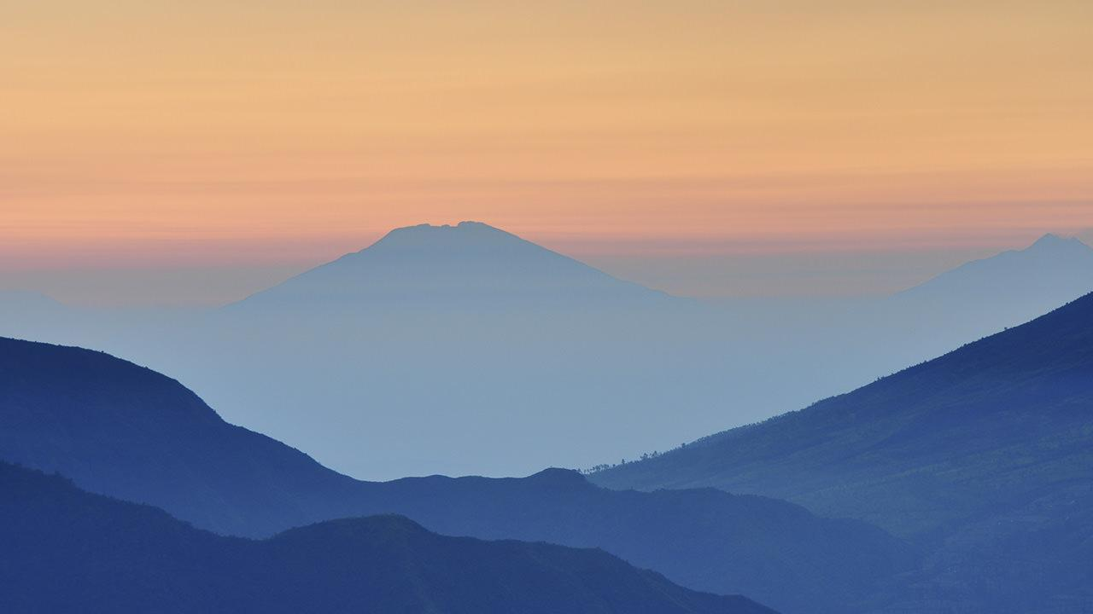
Want big impact? Use big image.

Slide 12
Use charts to explain your ideas
White
Gray
Black

Slide 13
And tables to compare data
 | A | B | C
Yellow | 10 | 20 | 7
Blue | 30 | 15 | 10
Orange | 5 | 24 | 16

Slide 14
Maps
our office

Slide 15
89,526,124
Whoa! That’s a big number, aren’t you proud?

Slide 16
89,526,124$
185,244 users
100%
That’s a lot of money
And a lot of users
Total success!

Slide 17
Our process is easy
first
second
last

Slide 18
Let’s review some concepts
Yellow
Is the color of gold, butter and ripe lemons. In the spectrum of visible light, yellow is found between green and orange.
Blue
Is the colour of the clear sky and the deep sea. It is located between violet and green on the optical spectrum.
Red
Is the color of blood, and because of this it has historically been associated with sacrifice, danger and courage.
Yellow
Is the color of gold, butter and ripe lemons. In the spectrum of visible light, yellow is found between green and orange.
Blue
Is the colour of the clear sky and the deep sea. It is located between violet and green on the optical spectrum.
Red
Is the color of blood, and because of this it has historically been associated with sacrifice, danger and courage.

Slide 19
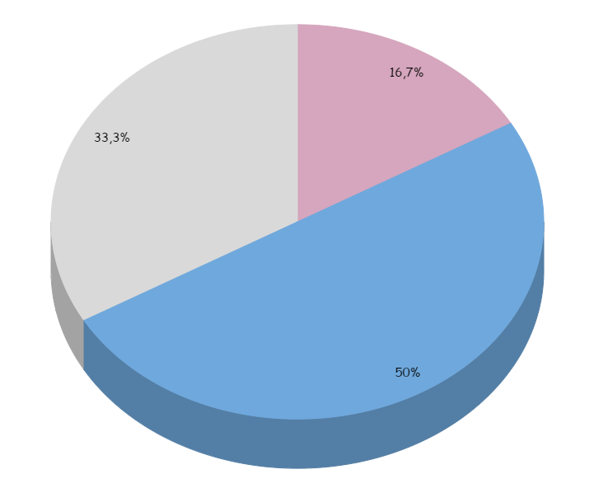
You can insert graphs from Google Sheets

Slide 20
Android project
Show and explain your web, app or software projects using these gadget templates.
Place your screenshot here

Slide 21
iPhone project
Show and explain your web, app or software projects using these gadget templates.
Place your screenshot here

Slide 22
Tablet project
Show and explain your web, app or software projects using these gadget templates.
Place your screenshot here

Slide 23
Desktop project
Show and explain your web, app or software projects using these gadget templates.
Place your screenshot here

Slide 24
Thanks!
Any questions?
You can find me at:
@username
user@mail.me

Slide 25
Credits
Special thanks to all the people who made and released these awesome resources for free:
Presentation template by SlidesCarnival
Photographs by Unsplash

Slide 26
Presentation design
This presentation uses the following typographies and colors:
Titles: Patrick Hand SC
Body copy: Sniglet
You can download the fonts on these pages:
https://www.fontsquirrel.com/fonts/sniglet
http://www.1001freefonts.com/patrick_hand_sc.font
You don’t need to keep this slide in your presentation. It’s only here to serve you as a design guide if you need to create new slides or download the fonts to edit the presentation in PowerPoint®

Slide 27
SlidesCarnival icons are editable shapes.
This means that you can:
Resize them without losing quality.
Change fill color and opacity.
Isn’t that nice? :)
Examples:

Slide 28
😉
Now you can use any emoji as an icon!
And of course it resizes without losing quality and you can change the color.
How? Follow Google instructions https://twitter.com/googledocs/status/730087240156643328
✋👆👉👍👤👦👧👨👩👪💃🏃💑❤😂😉😋😒😭👶😸🐟🍒🍔💣📌📖🔨🎃🎈🎨🏈🏰🌏🔌🔑 and many more...

